Slide 1


Slide 2
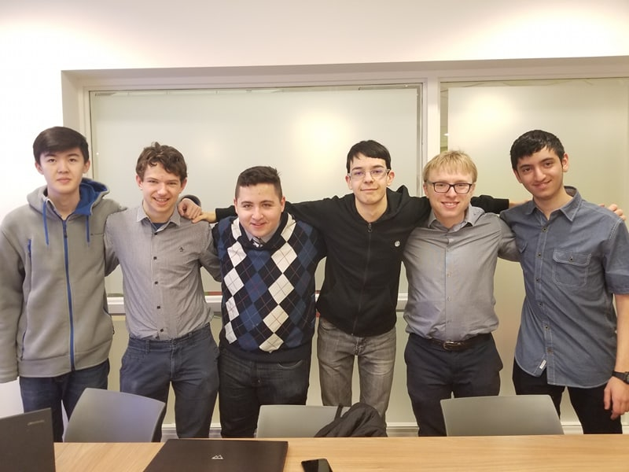

Slide 3




Slide 4




Slide 5

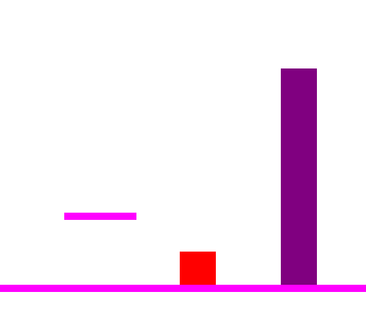

Slide 6
Residential Schools where a mandatory boarding school for all indigenous children. The schools were designed to commit cultural genocide
on the indigenous people of canada or as Duncan Campbell Scott( Previous Deputy Superintendent of indian affairs now known as indigenous affairs) said “residential schools were designed to take the Indian out of the child”. The first schools were operational in the 1870’s, but when did the last residential schools close?
1955
1920
1996
Viola Desmond is now on our $10 bill for refusing to sit in the black part of a segregated theatre. What year Did Viola Desmond refuse to be discriminated against by seating in the white part of the movie theatre?
1946
1998
1940

Slide 7
Special Thanks

Slide 8
Questions?

